Slide 1
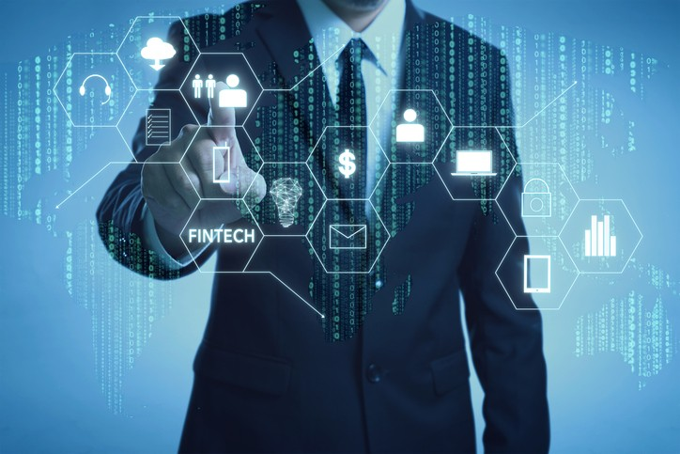
Project-1
Group 3 (Sam, Saeed, Julia & Prateek)
QUICKR PICKR

Slide 2
PROJECT DEFINITION
BACKGROUND
Finding new stocks to invest in can be a tedious task. From researching stocks, following the market, measuring returns, and so many other things, these tasks can take up so much of your time. Why sit behind your computer or on your phone for countless hours researching stocks, when you could be doing other things with your time. You have a whole life to live and enjoy. Don't get dragged down by these stifling tasks. Let the Quickr Pickr assist you.
QUICKR PICKR is a startup concept, with an idea to revolutionize the retail investor space in FinTech world. We are building an investment app for retail investors to invest safely using our wide range of professional products to make sound financial decisions for higher returns. QUICKR PICKER is an app based solution offering wide range of services:
RSI (Relative Strength Indicator)
Forward Price Earnings
PRODUCT STATE
Concept/Prototype
MOTIVATION
https://www.marketplacefairness.org/blog/retail-investors-statistics/
https://www.statista.com/statistics/1257441/retail-investing-market-share-usa/
VISION
TO BE
Minutes: 2 Max

Slide 3
PROJECT TIMELINE
KEY EVENTS
PROJECT
DEFINED
USER
STORIES
DATA COLLECTION
DESIGN
MVP
Post
Go-Live
Support
CODE BUILD
QA/UAT
GO LIVE
04 Aug 21
21 Aug 21
DOCUMENTING USER STORIES
CODE DEVELOPMENT
QA/UAT
ITERATION 2

Slide 4
CODE DEVELOPMENT
DATA COLLECTION
DATA CHALLENGES
CODING SOLUTIONS

Slide 5
RESULTS CONCLUSION
GOALS
DEMO

Slide 6
NEXT STEPS
INCREASING EFFICIENCY
INCREASING INDICATORS/FILTERS

Slide 7
Q&A

